Slide 1

Flight Delay Prediction
By: Marco Kan, Danial Darabi, Mahesh Gupta

Slide 2
The Problem
The Business
Tunisiair
Established in 1948
Flagship airline in Tunisia
2016-2018: average of 39,055 flights per year
Flight delays are causing:
Decrease efficiency
Increase capital costs
Lower customer demand
Loss of time and resources
1

Slide 3
The Solution
Build a model to accurately predict the flight delay to help:
Reduce impact of delays
Avoid loss time, capital and resources
Could help all stakeholders in the air travel ecosystem
2

Slide 4
Content
01. The Data
03. The Model
What we were given
What we created
02. The Research
04. The Results
What we discovered
What we saw
3

Slide 5

01. The Data

Slide 6

Exploring the data
The Raw Data consists of:
117,166 rows, representing flights between 2016-2018
107,833 Training Data
9,333 Test Data
9 columns such as ‘Date’, ‘Departure Point’, ‘Flight Status’ and ‘Aircraft Code’
All Categorical data
No missing values and correct data types
4

Slide 7
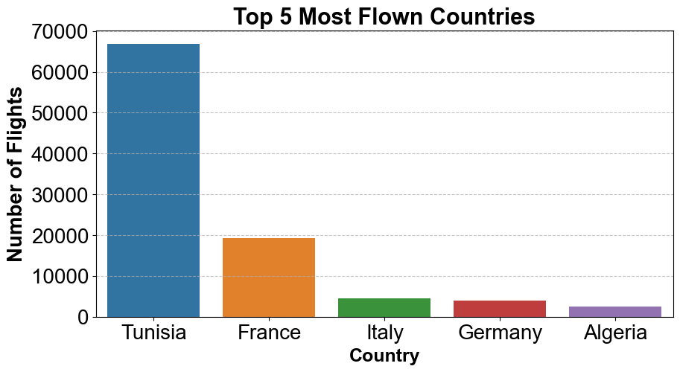
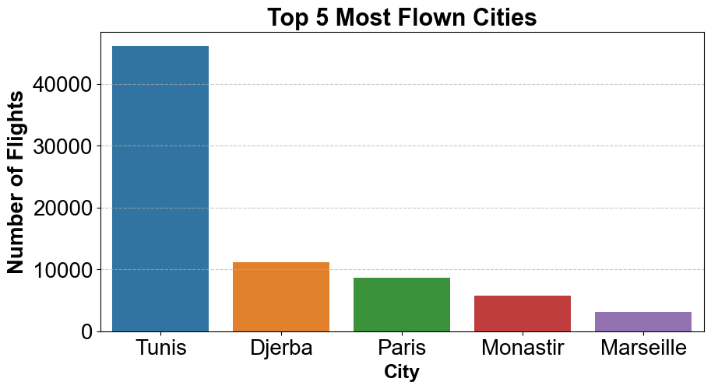
Flight Destination Data
As expected, Tunisia ranks the highest in total number of flights, followed by 3 European countries
3 of the 5 most popular cities are within Tunisia. The airline is popular among French speakers
5

Slide 8
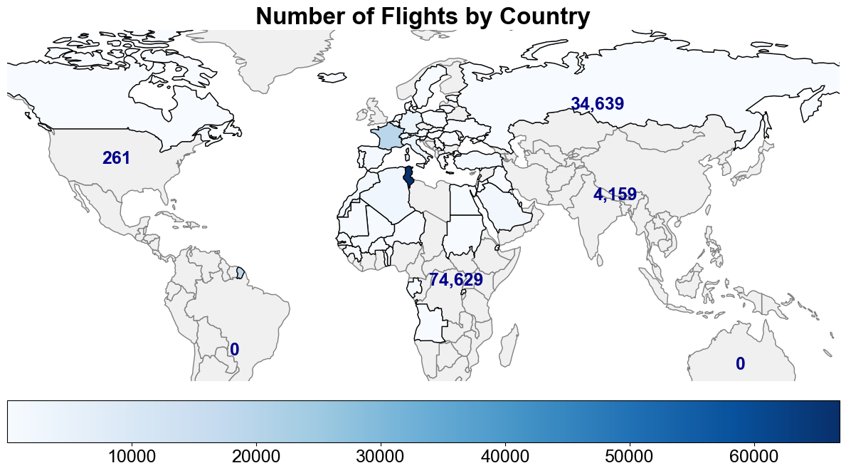
Country Data
The World Map and data shows the airline fly's to:
56 Countries
126 Cities
4 Continents
By far, most flights are in Africa and Europe
6

Slide 9
Flight Status Data
Flight Staus | No. of Flights
ATA - Actual Time of Arrival | 101,706
SCH - Scheduled | 14,470
DEP - Departed | 504
RTR - Ready to Return | 317
DEL - Delayed | 169
Many 0 delay flights as most flights arrive on time
Only a small percentage of flights are delayed
The small number of delayed flights means the prediction variable (delay) is not well distributed in the dataset
This makes the model prone to outliers, biased, and less effective on real data.
7

Slide 10
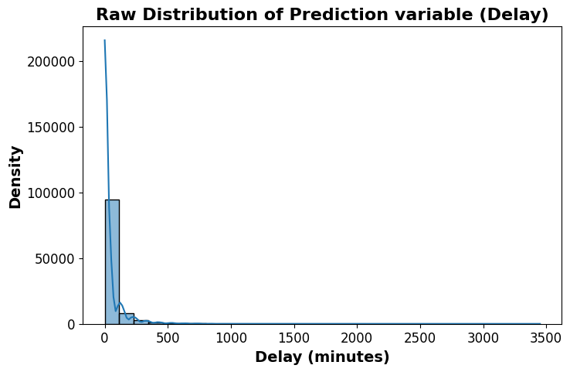
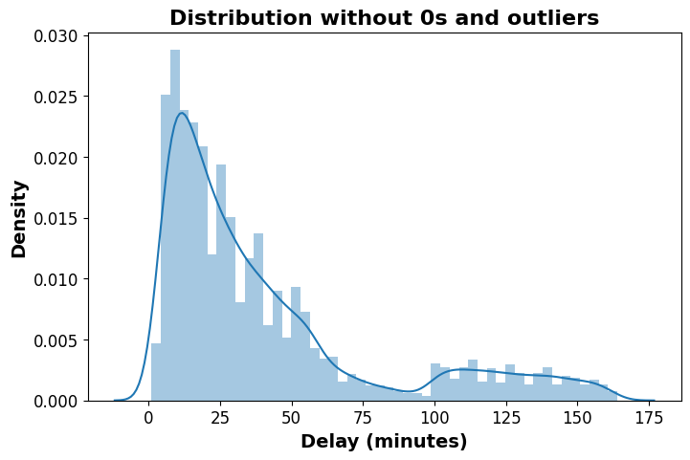
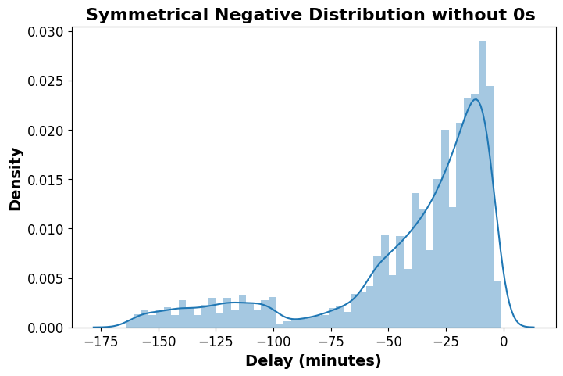
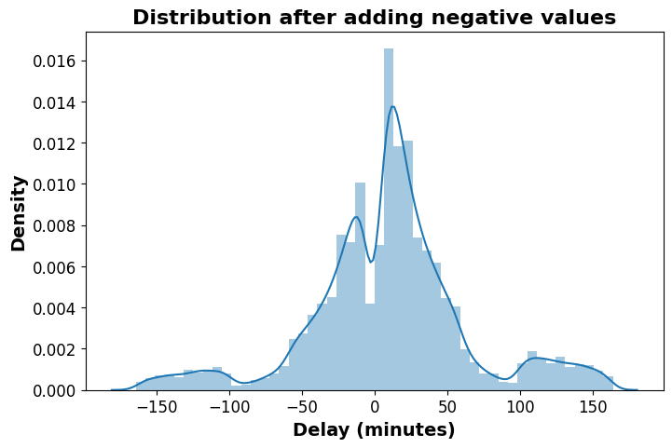
Fix Distribution
Step 1
Step 2
Identify the distribution and outliers. It is heavily right-skewed, starting with high 0 density
Remove the 0s and outliers to zoom in on the distribution. It now has a short tail at the start
Step 3
Step 4
Mirror the positive values for a random range of negative values. Making a new left-skewed distribution.
Add the positive and negative distributions together to get a normal distributed dataset
8

Slide 11

Business Goals
Evaluation Metric
Base / Dummy Model
RMSE – Root Mean Square Error
Shows performance with no learning
The RMSE shows how far the predicted delays are from actual delays – lower is better.
A baseline model has an RMSE of 118 (measured in minutes). The starting point to beat.
9

Slide 12

02. The Research

Slide 13




Feature Engineering
To improve the results, we need to give addition data to the modal
Research
Extract
Clean
Load
Research relevant domain knowledge about aviation travel
Extract data from external sources via download or APIs
Clean, standardize and check the new data
Load new data into the database via mapping
10

Slide 14






Added Features
1. Weather Data
8. Coordinates
Temperature, precipitation & wind of both departure and arrival destinations
The latitude & longitude of the departure and arrival destinations
2. Day/Night Data
7. Holiday
Morning/afternoon/evening, day of week/month, season and whether it is a weekend
Whether or not the departure country has a public holiday or not and its length
3. Airport Data
4. Distance in km
5. Expected Duration
6. Route
Aircraft Models and yearly total number of passengers in each of the 130 airports
The haversine distance between the departure and arrival airport in kilometres
The actual and expected duration of the flight in minutes.
The route of each flight from departure to arrival destinations
11

Slide 15
Added Features – part 1
1. Weather Data
2. Day/Night Data
Historical weather data was fetched using an API package library (meteostat) in python.
Data is collected from different geo stations around the world and matched to the nearest IATA (Airport code).
Derived from the ‘Departure Time’ column and split into separate categorical columns e.g...
2016-01-16 04:10:00
- Hour: 4
- Time of day: night
- Day of week: 6 (Saturday)
- Season: 1 (Winter)
12

Slide 16


Added Features – part 2
3. Airport Data
4. Distance in km
Number of Passengers – Gathered from different sources on the internet and put into a spreadsheet and mapped to the database.
The ‘airportsdata’ API package library in python was used to locate airport coordinates.
Haversine distance is:
“The shortest distance between 2 points on a sphere like Earth”
13

Slide 17



Added Features – part 3
5. Expected Flight Duration
6. Route
The ‘Expected Duration’ was derived by finding the median duration of each flight route, in minutes.
We were then able to calculate ‘Delay Relative to Expected’ & ‘Duration Ratio’
The ‘Route’ was simply derived from concatenating the ‘Departure Point’ with the ‘Arrival Point’
14

Slide 18
Added Features – part 4
7. Holidays
8. Coordinates
The ‘Is Holiday’ column was created using an API package library in python (holidays) to map each departure country to their respective public holiday days.
‘Holiday Length’ was also added and taken into consideration.
The coordinates were imported from the ‘airportsdata’ API package library and mapped to the database.
This includes the latitude and longitude of both departure and arrival destinations.
15

Slide 19








Feature Importance
Ranking the effect each feature has on the delay
Weather Data
Day/Night Data
Airport Data
Route
Distance in km
Holiday
Expected Duration
Coordinates
16

Slide 20
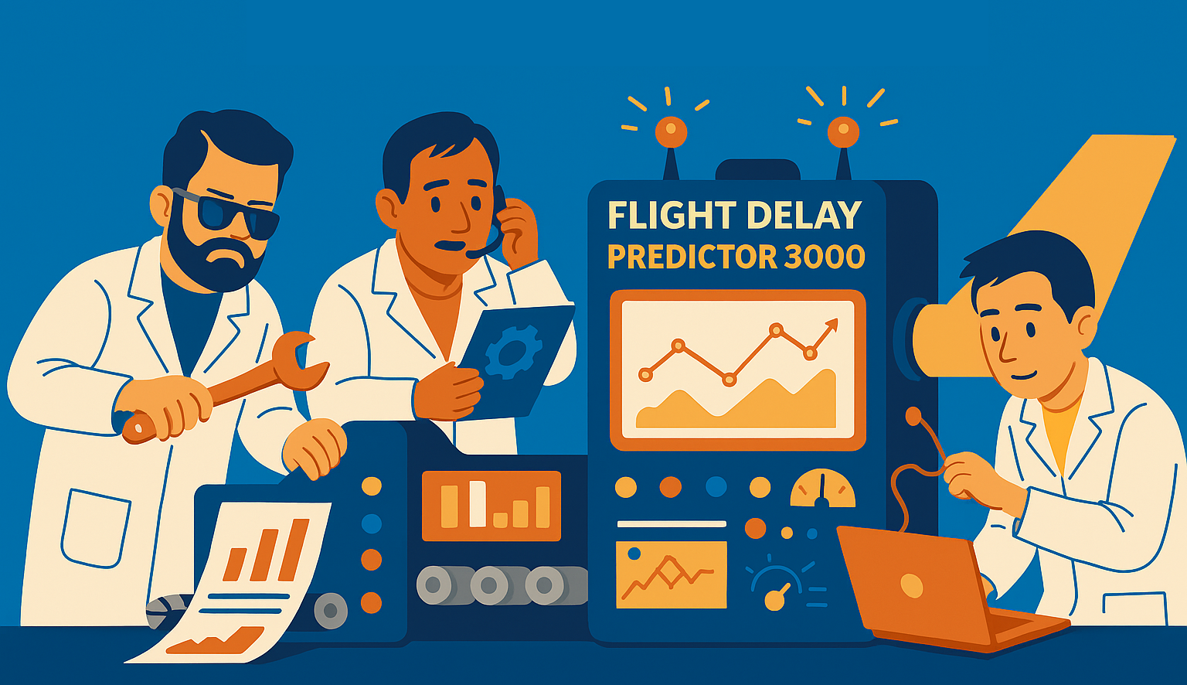
03. The Model

Slide 21


Modelling Process
We now use the new data to train a model and make predictions on delay times.
Training Data
9 base models
Main meta model
Test data
Prepare Training data
Train data on 9 base models separately
Combine predicted results and run on the main model
Feed the test data to the main model
This method is called ‘Stacking’
17

Slide 22

Model Selection – Part 1
It is a good idea to use a mix of models so there is a diversity in error patterns. We chose 9 base models and 1 main model. All can be separated into 3 categories
1. Tree-Based models – The Decision makers
Delay
No Delay
Each tree makes a series of Yes/No choices
Great for spotting patterns in messy, mixed data
Works well with numerical & categorical data
Like a group of experienced managers
6 of 9: Random Forrest, XGBoost, LightGBM, CatBoost, AdaBoost, GradientBoosting
18

Slide 23


Model Selection – Part 2
2. Straight Line Models – The Trend Spotter
The simplest way to explain the direction of change
Draws the best possible straight line
Focuses on the big picture rather than twists
Fast consistent and provide stability
Like using a compass for directions
1 of 9: Ridge Regression
19

Slide 24

Model Selection – Part 3
3. Similarity Models – The Pattern Matchers
Compares existing data to similar new ones
Works better with numerical data e.g. ‘Duration’
Fits a smooth curve that best suits the data
Good at finding patterns that other models missed
Like spotting a look-alike in a crowd
2 of 9: KNearestNeighbor (KNN), Support Vector Regression (SVR)
20

Slide 25
Final Main (Meta) Model
After all predictions are made, the meta model is used combine all the results to make a final model. It is now ready for use on real test data.
XGBoost – The Judge
Fast enough to train on many stacked data
Weighs stronger & weaker models differently
Combines in a smart way, not just averaging
Like an experienced judge that listens to all witnesses
Who is more reliable in each situation
When to give more weight to specialist
21

Slide 26
Base Models - Fine Tuning
To improve the RMSE further, we fine tuned each of our base models
Base Model
Before Tuning | After Tuning
Improvement
Random Forrest
32.72
32.57
0.15
XGBoost
32.95
32.32
0.63
LGBM Regression
32.98
32.49
0.49
CatBoost
31.03
31.01
0.02
Ada Boost
35.91
33.04
2.87
Gradient Boosting
34.13
32.68
1.44
Ridge
33.78
33.78
0.00
KNearest Neighbour
35.27
33.51
1.76
SVR
34.93
34.50
0.43
22

Slide 27

Pipeline
We use a pipeline to process the data and fine tune the base models to get the best possible final model. The test set is then used on this model to get the flight delay predictions.
Base Model fine tunning
Before fine tuning the final model, we got an RMSE of 20.98
After fine tuning the final model, we have an RMSE of …
23

Slide 28

04. The Results

Slide 29
RMSE: 118 20.67
Our model is around 21 minutes off the actual delay time
About 83% Improvement
24

Slide 30
Submission to Zindi
Public Score: 98.61
Rank: 188 / 289
25

Slide 31

The Waiting Game…

Slide 32
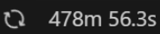
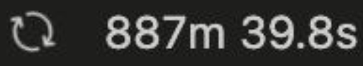
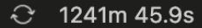

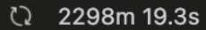
Model Processing…
We spent a considerable amount of time waiting for our models to finish…
26

Slide 33







Future Improvements
Domestic vs International
Airport Strikes
Number of Runways
Additional Features
Better Model tunning
Cloud Computing Service:
27

Slide 34








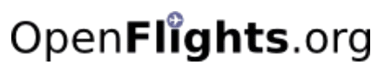
Technology Stack
28

Slide 35

Thanks for listening!

